Slide 1
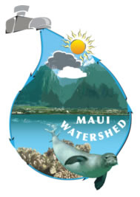
Southwest Maui Watershed Plan
Prepared For:
Hawaii Department of Health
Clean Water Branch and
The U.S. Environmental Protection Agency
Prepared By:
Michael Reyes – Watershed Coordinator
Central Maui Soil & Water Conservation District
77 Hoʻokele St., Suite 202
Kahului, HI 96732
808-871-5500, ext. 101
Funding Provided By: County of Maui Office of Economic Development
Fiscal Sponsor: Tri-Isle RC&D

Slide 2
Introduction:
The Southwest Maui Watershed Plan (SMWP) was developed to include the 49,688-acre planning area designated by the State of Hawaii as the Hapapa, Wailea, and Moʻoloa watersheds. The planning area extends from near the summit of Haleakala down to coastal areas, with 11 major drainage basins discharging to the Kihei, Wailea, and Makena coastlines.

Slide 3
Purpose
The Central Maui Soil and Water Conservation District identified sediment carried by storm water runoff as the primary source and most problematic pollutant in the Southwest Maui Watershed.
Causes of sediment runoff were identified and implementation projects were designed to reduce sediment laden stormwater runoff before it discharges into the ocean.
Methods were developed to measure sediment load and estimate sediment load reductions by implementation projects.
A water quality monitoring program was designed and implemented to ensure the water quality was accurately characterized throughout the watershed.
The Plan has been created so that implementation projects that will reduce erosion and sedimentation are eligible for Federal 319 Grant Program funds.

Slide 5
Background
During the original effort, over $194,000 in Federal 319 grant funding was spent in an attempt to get the Southwest Maui Watershed Plan up to priority status.
Unfortunately, major deficiencies were found in the original Plan and it is not currently recognized as a priority watershed by the Environmental Protection Agency (EPA) or the Hawaii Department of Health (DOH) Clean Water Branch (CWB).
Because of this, the Plan in its current condition is not eligible for Federal 319 Grant Program funds and the various projects for improving water quality within the watershed are not able to be implemented.

Slide 6
Current Status
In 2015, in an effort to breathe new life into the Southwest Maui Watershed Plan, the Central Maui Soil and Water Conservation District began discussions with the Maui County Office of Economic Development to obtain a small grant to address the deficiencies identified by the DOH CWB and the EPA in the original Plan.
After attending many Maui County Council and Budget and Finance Committee meetings, the Central Maui Soil and Water Conservation District was able to secure a County grant through the Office of Economic Development for $50,000.
Michael Reyes was named as the Watershed Coordinator in 2017 to address the deficiencies of the original Plan and to ensure the Plan is elevated to priority status by the EPA and DOH CWB so that we may become eligible for 319 Grant Program funding for implementation projects.

Slide 7
FOUR MAJOR DIFICIENCES OF THE ORIGINAL PLAN
No Empirical Data - The plan must offer load reduction estimates for each of the proposed implementation projects listed in the watershed plan.
Water Quality Monitoring Plan - We need to develop a robust monitoring and assessment plan to capture the effects of our implementation projects.
We need to create maps showing the specific locations where measurements will be taken and explain why these locales were chosen.
We need to develop a project timeline with milestones for determining project progression.

Slide 8
Existing Conditions

Slide 11
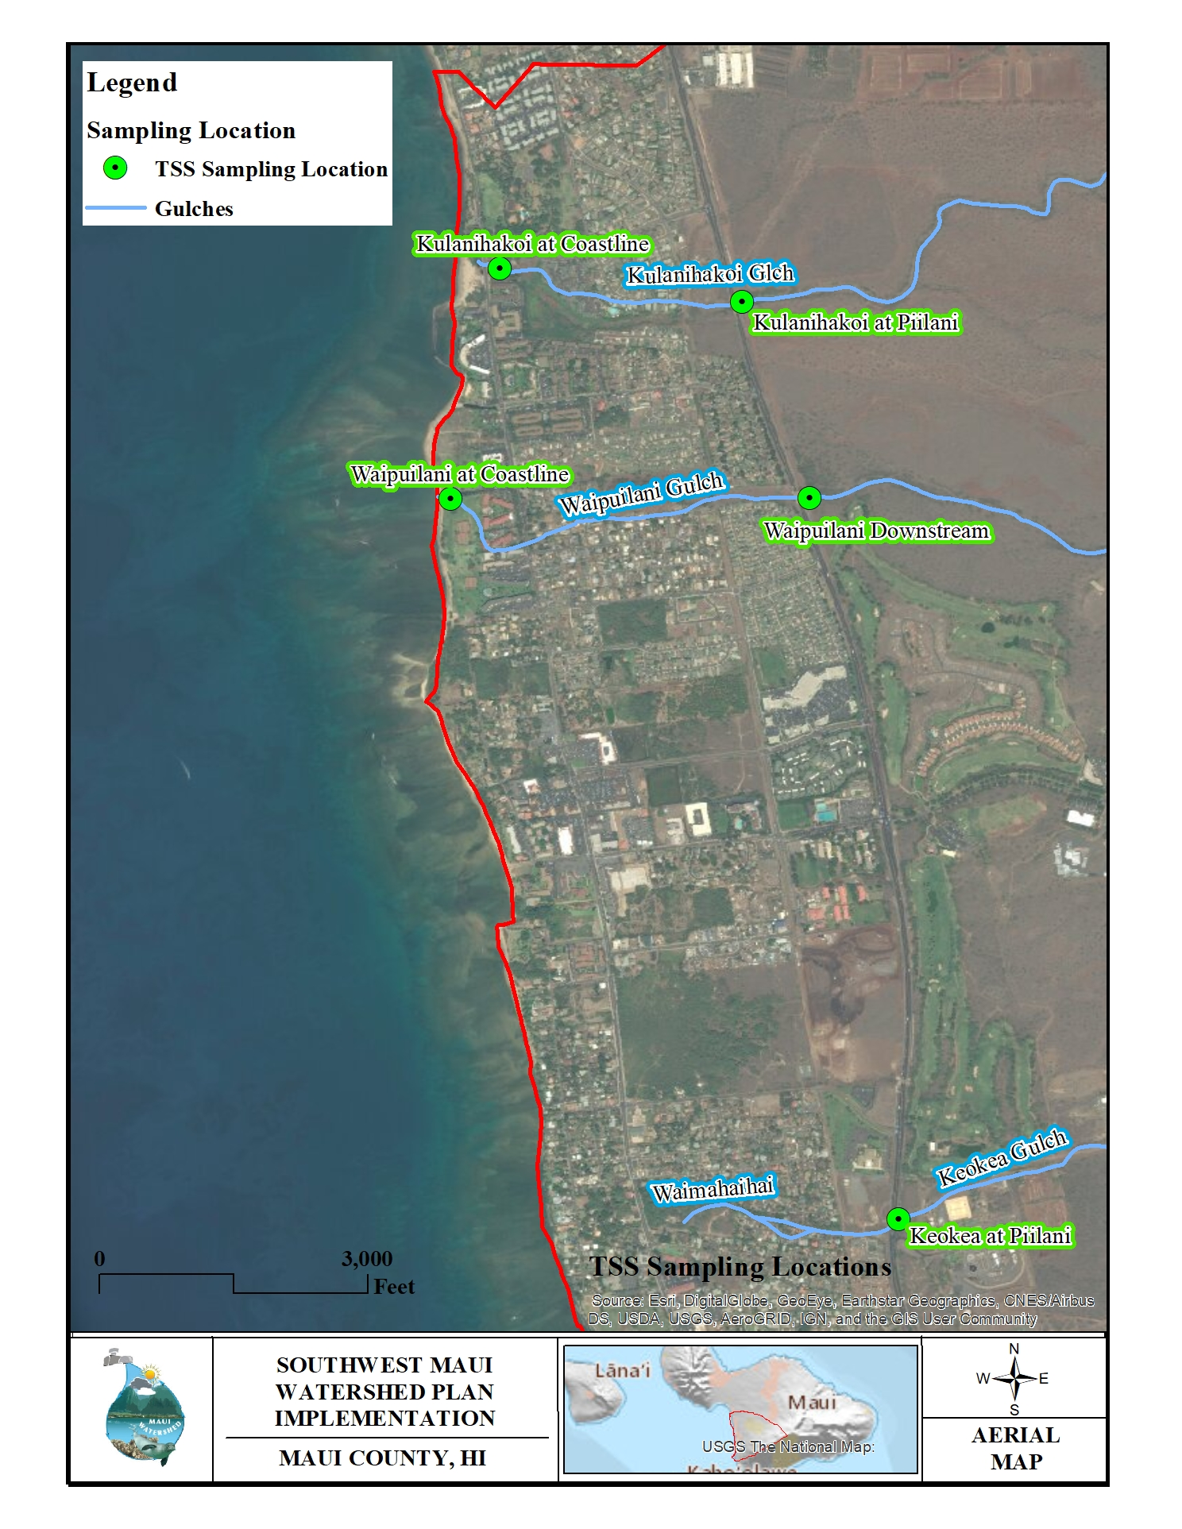
Kihei Sampling Locations

Slide 12
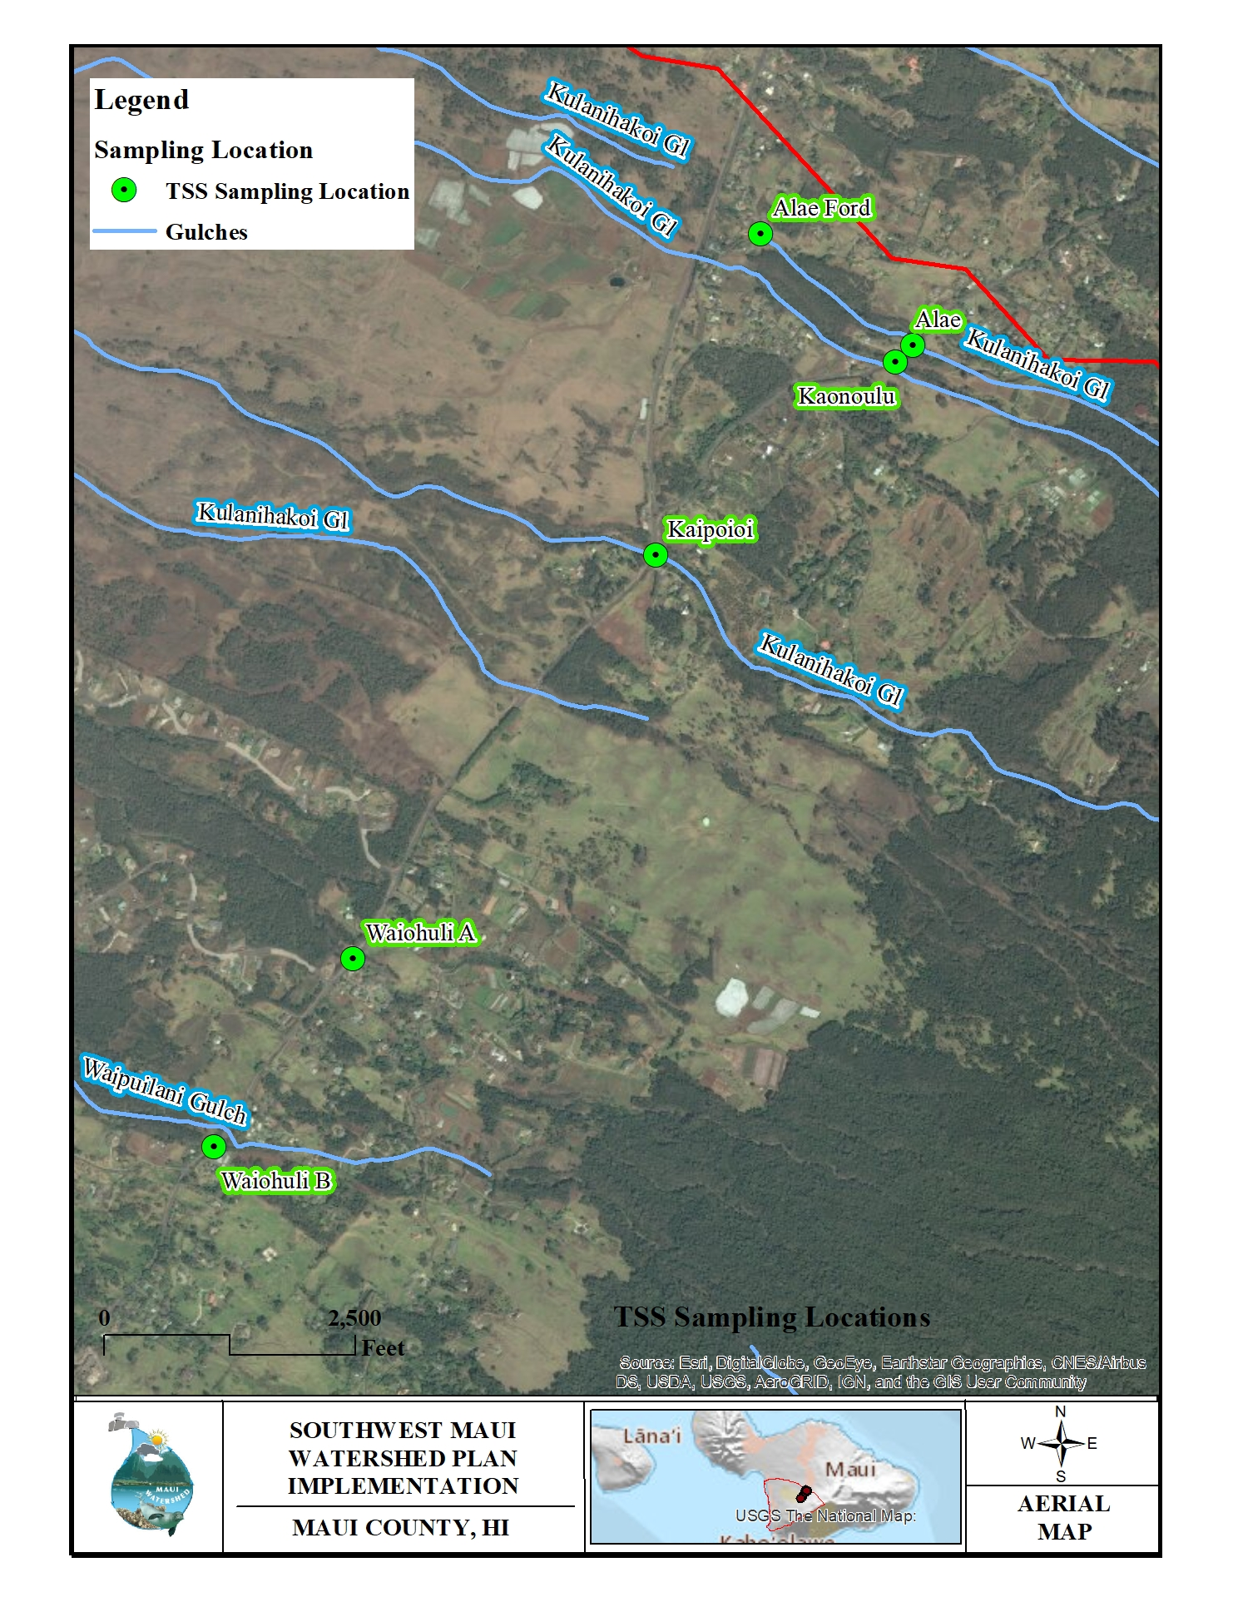
Upcountry Sampling Locations

Slide 13
Waipuilani Gulch – April 2017

Slide 14
Keokea Gulch – April 2017

Slide 15
Why these sites?
Prioritizing implementation projects associated with Kulanihakoi, Waipuilani and Keokea Gulches since these areas are most prone to flooding and have the highest levels of sediment discharge within the watershed.

Slide 16
April 30th, 2017 Sediment Discharge Load
Qs=Qw*Cs*K
Sample Location |  | Qw | Cs | K | Qs | tons per hour
 |  | ft³/sec | TSS in mg/L | 0.0027 | tons per day
1 | Kulaniakoi at S Kihei | 124.33 | 1215.58 | 0.0027 | 408.07 | 17.00
2 | Kulaniakoi at Piilani | 102.62 | 1802.64 | 0.0027 | 499.48 | 20.81
3 | High Intensity Zone Downstream | 1.08 | 45.69 | 0.0027 | 0.13 | 0.01
4 | High Intensity Zone Upstream | 6.17 | 28.21 | 0.0027 | 0.47 | 0.02
5 | Keokea Downstream | 2.06 | 393.90 | 0.0027 | 2.19 | 0.09
6 | Keokea Upstream | 2.59 | 405.79 | 0.0027 | 2.84 | 0.12
7 | Alae | 19.29 | 93.66 | 0.0027 | 4.88 | 0.20
8 | Ka'onoulu | no flow data | 55.91 | 0.0027 | NA | NA
9 | Kaipoioi | no flow data | 443.97 | 0.0027 | NA | NA
10 | Waiohuli A | 15.06 | 75.25 | 0.0027 | 3.06 | 0.13
Additional data from the October 2017 rain event is currently being processed by the lab

Slide 17
Future Conditions
Potential future sediment load reduction values were calculated using The United States Department of Agriculture Revised Universal Soil Loss Equation 2 (RUSLE2). Areas within the watershed where implementation projects have been proposed were analyzed for erosion potential using RUSLE2. The four main factors affecting erosion are soil, climate, topography and land use. For each implementation project location, these factors were entered into the RUSLE2 database to calculate the erosion potential in tons per acre per year.
Sediment loss was estimated to be 25 tons per acre per year using the RUSLE2 equation for the areas where the initial implementation projects are being proposed. These implementation projects were identified as being the most feasible based on their location, ownership, cost, potential for success and general “shovel-readiness”.

Slide 18
Initial Implementation Projects
Two High Impact Zone Mitigation Sites (HIZMS) have been identified.
Two Detention Basins have been proposed

Slide 19
Sediment Load Reduction Estimates for Proposed Implementation Projects
Proposed Implementation Project | RUSLE2 Coefficient | Acreage Affected | Sediment Load Reduction Estimate (Tons per Year)
High Impact Zone Mitigation Site 1 | 25 Tons per Acre per Year | 46.79 | 1169.75
High Impact Zone Mitigation Site 2 | 25 Tons per Acre per Year | 27.78 | 694.5
Detention Basins | 25 Tons per Acre per Year | 38.11 | 952.75

Slide 20
Additional Implementation Projects
Excavated basins in series connected by berms or channels, for sedimentation and infiltration purposes, have been identified as having a high priority as a management measure to improve water quality in the watersheds. These basins slow water moving downslope, removing sediment and acting as a means for aquifer recharge and flood prevention.
Wetland Restoration - Existing wetlands along the coast of Kihei Wailea and Makena should be delineated, protected and restored wherever possible. Like the detention basins discussed above, wetlands have the ability to filter stormwater for sediment, nutrients and pathogens. They are habitat for native flora and fauna. They serve as flood prevention and aquifer recharge locations. Lastly, wetlands represent greenspace within urban communities and improve the community’s relationship with the natural environment.
Riparian buffers along gulches and gullies prevent sediment laden sheet flow from entering gulches and gullies. They also offer important habitat for native flora and fauna.

Slide 21
Proposed Structural Implementation Projects
Excavated Basins / Excavated Basins in Series
Riparian Buffers
Stream Diversions
Vegetated Swales and Berms
Stabilization of Unpaved Roads
Utilization of Existing Detention Basins (Piʻilani Detention Basin)
Expansion of Existing R-1 Infrastructure

Slide 22
Proposed Non-Structural Implementation Projects
Watershed Coordinator
Water Quality Monitoring
Grazing Management Strategies
Education and Outreach
Illegal Dumping Controls

Slide 23
Moving Forward
The revised Southwest Maui Watershed Plan has been submitted to the DOH CWB for review. The website (www.mauiwatershed.org/home) will be updated with the new Plan once edits and comments have been received from the DOH CWB.
The new Plan addresses the four deficiencies identified in the original Plan.
Greg Takeshima is currently on paternity leave until December of 2017 and will not review the revised Plan until his return.
The Central Maui Soil and Water Conservation District has reached out to rural land owners and are working on beginning implementation projects to show their viability without Federal funding. The hope is that by setting examples of successful implementation projects in the watershed, the DOH CWB and the EPA will be more inclined to financially support future implementation projects.
Potential wetland restoration sites are currently being identified in an attempt to save what is left of the Kihei coastal wetlands.

Slide 24
How can I help you?
Please visit mauiwatershed.org/contact-us-1
Or email me directly at:
mreyesecology@gmail.com

Slide 25
Mucho Mahalos!
I would like to personally thank Mike Moran for allowing me to speak with you.
Thank you to everyone in the community who has donated their time and efforts to ensuring our wetlands and coastline are protected for the future.

